Slide 1


ENSE 489 Project Presentation
Yuting Li
200434800

Slide 2
U.S. Prison System Overview
Wagner (2022) has found in his research that that in the U.S. Prison System:
Two million Prisoners.
$182 billion every year on the prison system every year.
76.6% of prisoners are rearrested within five years.

Slide 3
Recidivism Rate
Recidivism is a term used to describe the tendency of a prisoner to commit another crime after being released.
In the U.S. the likelihood of recidivism is a crucial factor that can affect the prison time of a prisoner. The higher the recidivism chance, the longer the prison time.

Slide 4
AI Solution
As AI technology develops, the U.S government seeks new opportunities to become more efficient in predicting an offender’s recidivism rate by using AI technology. The advantage of this is that AI can do it a lot faster, can handle more workload and people believe that AIs are more objective

Slide 5
COMPAS
NorthPointe is a private company that develops and sells AI product that can examine the recidivism rate of prisoners (Julia 2016). This COMPAS algorithm will examine “more than 100 factors, including age, sex and criminal history.” (Corbett 2016) of a prisoner and assign him/her a score, from 1 to 10, the higher the score, the higher the probability of re-offending in the future.

Slide 6
Machine Bias?
In a research led by a non-profit organization called ProPublica, researchers have collected information for over 10 thousand people that had committed a crime and were arrested in Florida. These prisoners are being scored by COMPAS and researched checked to see how many of them were charged with further crimes within two years (Julia 2016). The outcome of this research is shocking, the result showed that black defendants were twice as likely to be incorrectly labelled as having a higher risk than white defendants.

Slide 7
Project Objectives
Investigate
Improve
01
02
whether there is machine bias within the system of COMPAS
the recidivism predictor

Slide 8
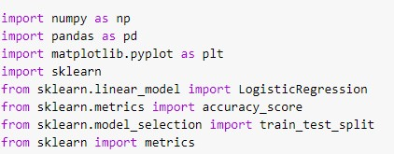
Libraries being used
Numpy
NumPy stands for Numerical Python.
It provides functions for linear algebra, matrices and etc.
Pandas
Pandas is a Python library for data sets.
It has functions for analyzing, cleaning, exploring, and manipulating data.

Slide 9
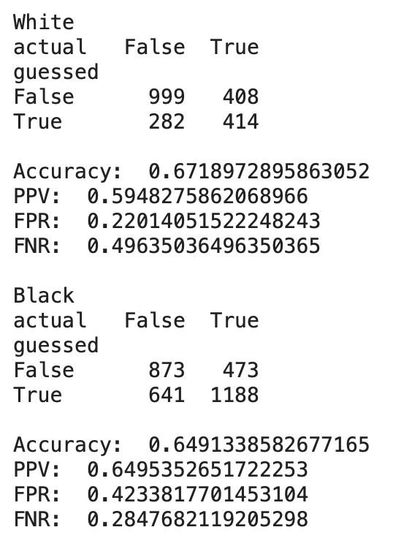
Analyzing Results
The overall accuracy for both the white (67%) and black (64%) offenders are pretty close to each other.
White defendants are having a higher false-negative rate
Black defendants are having a higher false-positive rate

Slide 10
Logistic Regression
Used for classification and prediction purposes
Supervised learning
Easy to implement
It can interpret model coefficients as indicators of feature importance.

Slide 11
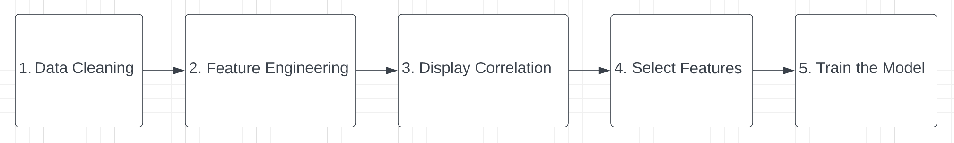
What if we don’t use “race” as an input?
Data Cleaning: this step is to correct the structural errors in data sets. I did this step by reading the documentation provided by ProPublica and eliminated duplicated and illegal entries accordingly.

Slide 12
Feature Engineering
Feature Engineering: This step is to process the data into a way that the machine can work with it in better ways. In this step, binary form and decimal form are preferred.
For example instead of display “Male” and “Female”, I made the sex to display “1” and “0”. “1” representing “Male” and “0” representing “Female”.
For inputs that can be categorized into groups, I have created dummy variables for them. For example: for the input column “age_categories”, we used to have inputs of “Less than 25”, “25-45” and “Greater than 45”. I created three dummy variable each representing one category and used “1” and “0” to represent true and false.

Slide 13
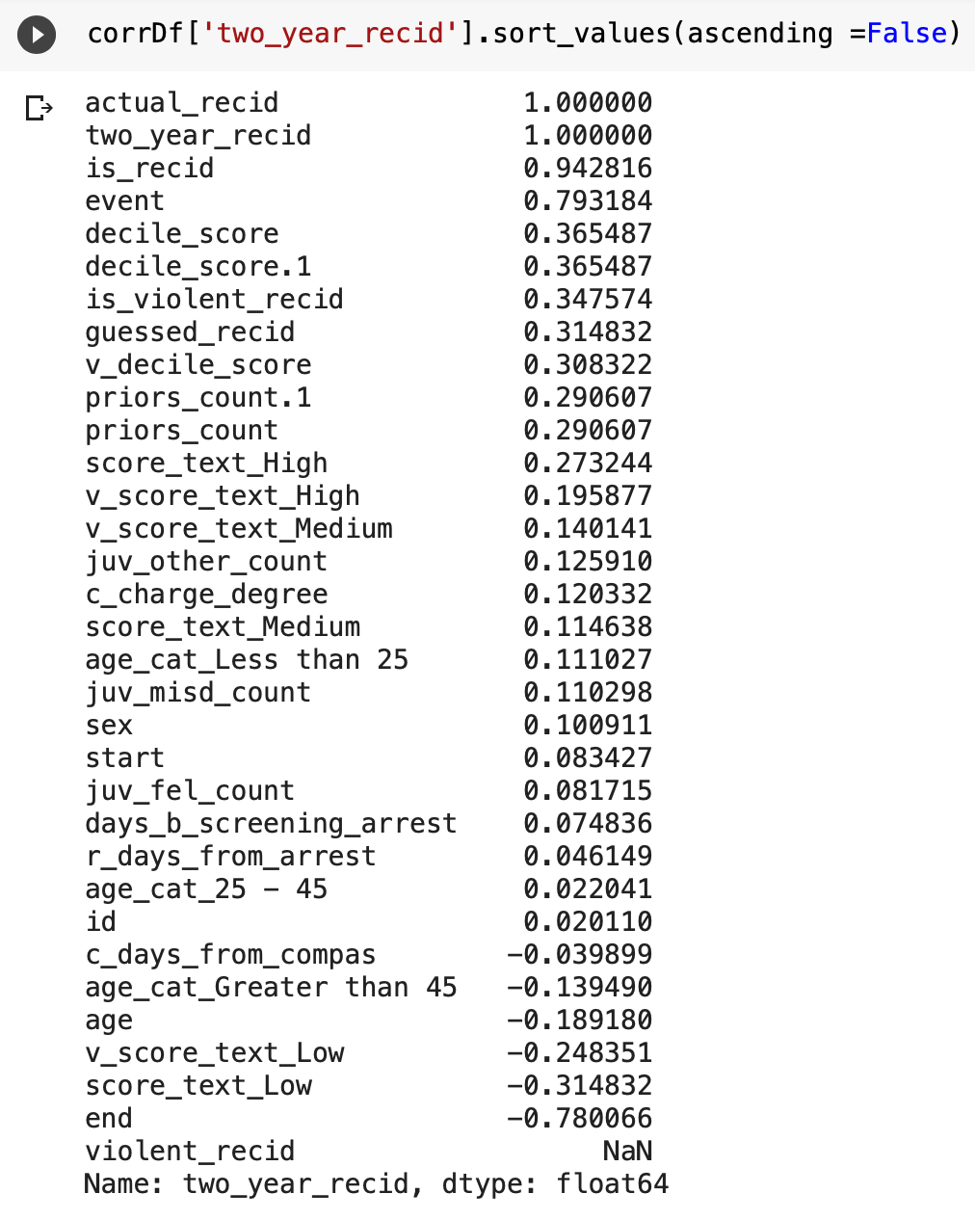
Find Correlation
Display Correlation: in this step, I displayed all the features that show correlation with the two year recidivism. The numbers range from positive one to negative one, the greater the number, the stronger the correlation; positive number means positive correlation and negative number means negative correlation. Positive means that if the offender has this feature, his probability of re-offend will increase; negative correlation means if the offender has this feature, the reoffend rate will be decreases.

Slide 14
Feature Selection
Select Features: this is the most important part of the entire project, the quality of the features will directly affect the overall accuracy rate and will directly affect whether or not my project will succeed. I sticked to a set of standards during this process:
Inputs that are in string type (names, charge description) are eliminated
All inputs that are redundants to each other are eliminated. For example, inputs “actual_recid”, “is_recid” and “two_year_recid”
Inputs without documentation from the data source are eliminated. For example, input “end” and “event” all shows extremely strong correlation (-0.78 & 0.79) to the recidivism rate but I cannot justify my AI with inputs that I cannot understand.

Slide 15
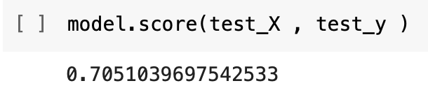
Model Training
Train the model: I used all the inputs that are left in step 4 and trained my model using logistic regression, the split of my model is 80% for training and 20% for testing and the overall accurate is about 70% which is higher than the 63% accuracy rate of the COMPAS algorithm

Slide 16
Any Questions?

Slide 17
Thanks for watching!

Slide 18
References

Slide 19
Wagner, P. (2022). United States profile. United States profile | Prison Policy Initiative. Retrieved July 25, 2022, from https://www.prisonpolicy.org/profiles/US.html
Corbett-Davies, S., Pierson, E., Feller, A., & Goel, S. (2021, December 7). A computer program used for bail and sentencing decisions was labeled biased against blacks. it's actually not that clear. The Washington Post. Retrieved June 7, 2022, from https://www.washingtonpost.com/news/monkey-cage/wp/2016/10/17/can-an-algorithm-be-racist-our-analysis-is-more-cautious-than-propublicas/
Julia Angwin and Jeff Larson, Bias in Criminal Risk Scores Is Mathematically Inevitable, Researchers Say, ProPublica, Dec. 30, 2016

